Slide 1
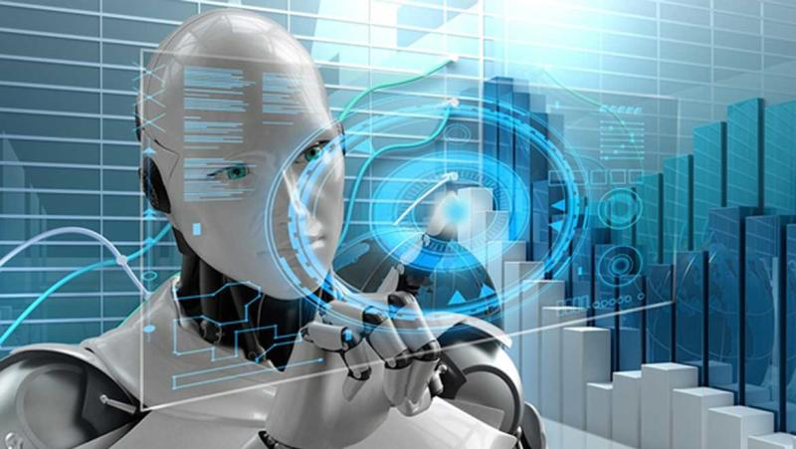
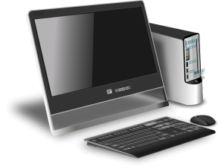


IT FEST
ONLY FOR STUDENT OF COMPUTER SCIENCE DEPARTMENT
PLEASE DO NOT FORGET
ON 28.AUG.23 AT 12:30 PM
VENUE: DEPARTMENT OF COMPUTER SCIENCE

